Slide 1
WEB524 WEB PROGRAMMING ON WINDOWS WEEK 8 – LECTURE 1 CREATING A PERSISTENT STORE

Slide 2
Review Weeks 2 - 6
We used the Chinook sample database consisting of several entities (for example: customer, employee, invoice, track, album, etc.).
This sample database was included in the project template (Web App Project Template v1).
In the Entity Models folder:
There are several classes for real-world entities and their associations with other classes.
The design classes were created using a Visual Studio code generator by examining the structure of an existing database (Chinook).
There is a code file that defines a data context - the app’s gateway to the persistent store (database).
The data context includes DbSet<TEntity> collection property definitions for each entity in the design model. These properties are used by the Manager class methods to perform typical data service tasks (fetch, add, edit, and delete).

Slide 3
Review Week 7
You were introduced to security.
You created a new project that used the built-in Visual Studio MVC Web App template configured to use “Individual User Accounts”.
You saw that there were no design model classes. Visual Studio creates a new web app with the foundational components and expects that you will add your own data model.
You saw that the data context class was located in an IdentityModels.cs code file. A web app with security needs the foundational components needed for identity management, authentication, and authorization. This source code file configures some of these components, including the data context.

Slide 4
Review of Persistent Storage in MVC
In an ASP.NET MVC web app, persistent storage for the data model is provided by the Entity Framework.
You should, review the week 2 lecture notes. They introduced:
Persistent data storage in a database
Facade service (Entity Framework)
Design model classes
You have created web apps that included those components as part of the new-project template.
You can create and configure these components yourself, but you don’t need to in this course. But…

Slide 5
Creating your own Persistence Layer (Existing)
If you’re interested in creating your own persistence layer and adding to an existing project:
Using the NuGet Package Manager Console, install-package entityframework install-package automapper
Add a connection string to the web app’s Web.config file.
Write one or more design model classes.
Write a data context class (that inherits from DbContext) and add DbSet<TEntity> properties for the design model classes that will be persisted.
Add a “manager” class that will handle data service tasks for the app.
After the above steps, you will have a project like template provided by your teacher.

Slide 6
New Project Template with Authentication
A new project with security has source code files and classes that are slightly different than those you worked with earlier in the course:
There are no design model classes
The data context class is in the IdentityModels.cs code file
This kind of project is ready for your own data model. You will need to:
Use the NuGet Package Manager Console, install-package automapper.
Write one or more design model classes
In the data context class, add DbSet<TEntity> collection properties for the design model classes.
Add a “manager” class that will handle data service tasks for the app.
This is still a lot of work! Your teacher has created another template that captures this work

Slide 7
Web App Project v2 template
This new template includes starter code for the tasks outlined in the previous slide. You will need to do tasks 2, 3 and 4.
Prepare your computer and test the new template.
Download the template and add to the templates folder (just like you did for v1).
Create a new throw-away project based on the new template. Build/compile and then run the web app.
When the web app loads, the home page outlines two important tasks:
Customize the role claims.
Write the design model classes.
A full tour of the web app’s features are highlighted in the Task List. Open it to view the list of “TODO” comment tokens.

Slide 8
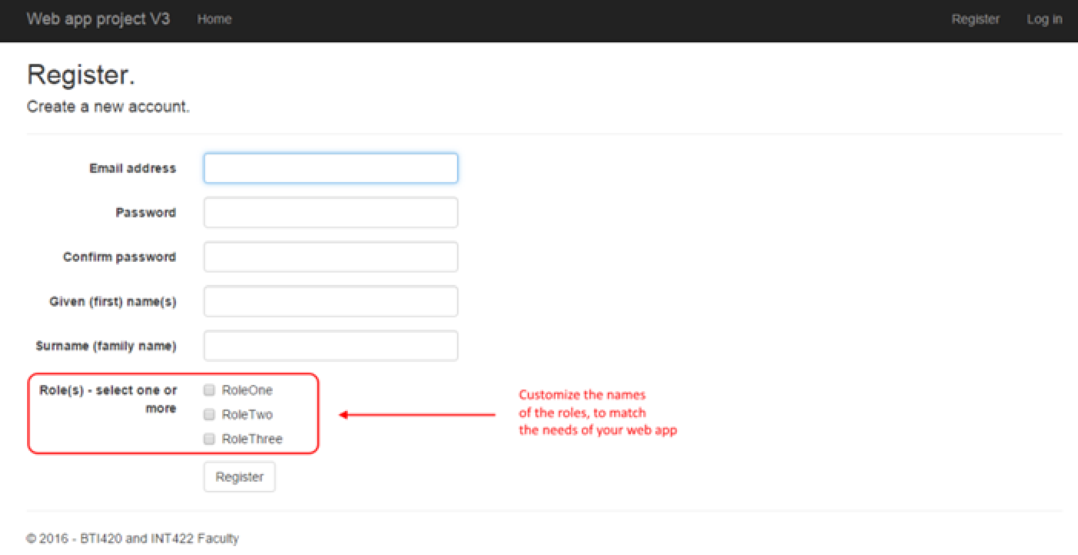
Web App Project v2 template Register
If you run the “Register” action, you will notice that the form includes generic or placeholder names for the role claims.

Slide 9
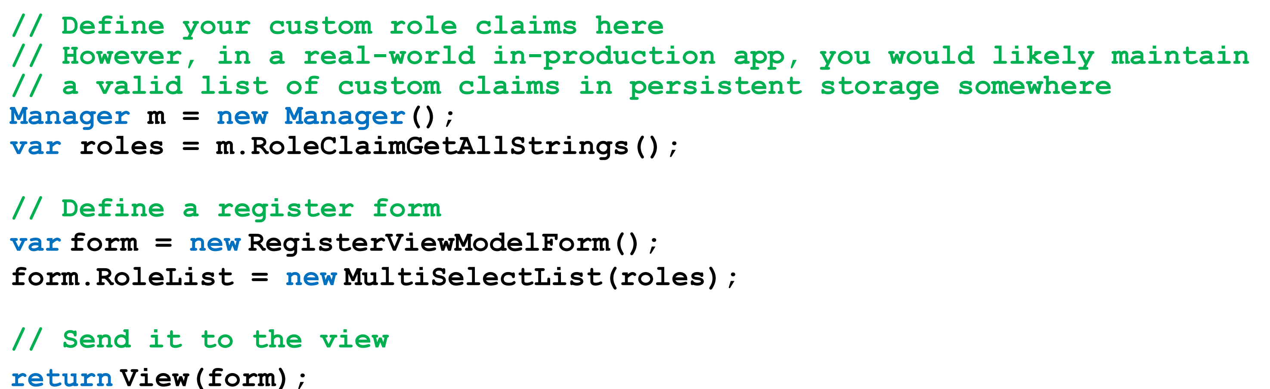
Web App Project v2 template Roles
The roles, e.g. RoleOne, RoleTwo, RoleThree, will not show up on the page until you load them in the persistent storage.
In the project template, they are defined in the GET (form-building) Register() method in the account controller:

Slide 10
Web App Project v2 template Roles
As it states in the code comments, in a real-world in-production app, you would likely maintain a valid list of custom claims in persistent storage.
A general approach is to define an entity set RoleClaim in your design model and use it as a “lookup table”.

Slide 11
Defining and Creating a New Persistent Store

Slide 12
Design Model Class - Conventions
Remember these rules and conventions when writing design model classes. They ensure that the database is initialized and configured correctly, and will improve the quality of other coding tasks as you build the app.
Add your design model classes to the Data folder.
Name the unique identifier property Id and use int data type. Why not EntityId?
Valid data annotations are pretty much limited to [Required] and [StringLength(n)].
Do NOT configure scalar properties (example: int, double) with the [Required] attribute
When defining an association between two classes, navigation properties MUST be configured in both classes
Required “to-one” navigation properties must include the [Required] attribute
“To-many” navigation properties must be of type ICollection<T>, initialized as HashSet<T>.
Initialize DateTime properties and default data in the no-argument constructor.

Slide 13
Design Model Class Diagram
After you write your design model classes, you should create a class diagram. It will give you a visual way to verify that you have coded the design model classes correctly.
After completing the design model classes, add DbSet<TEntity> properties to the IdentityModels.cs source code file.

Slide 14
Database Creation
When does the database get created by the database engine?
Recall that the data context class is the “gateway” to the persistent data store.
By convention, the first time a database is accessed, read or written to, the data context calls a “database initializer”.
The database initializer that is called will create the database if it does not exist.
If the database does exist, then the database initializer will see it and will return without making any changes.

Slide 15
Adding New Objects to the Persistent Store

Slide 16
Adding New Objects to the Persistent Store
After defining a data store, we can programmatically add new objects.
In the ASP.NET and MSDN documentation, the “initializer” strategy is discussed, demonstrated, and recommended. It is a convention-based strategy, that uses a Seed() method to populate the data store with new objects.
We have used this in past versions of this course, but …
Going forward, we will use a new “Manager Load” strategy that is a bit simpler to understand and is compatible with a future “bulk data load” topic.

Slide 17
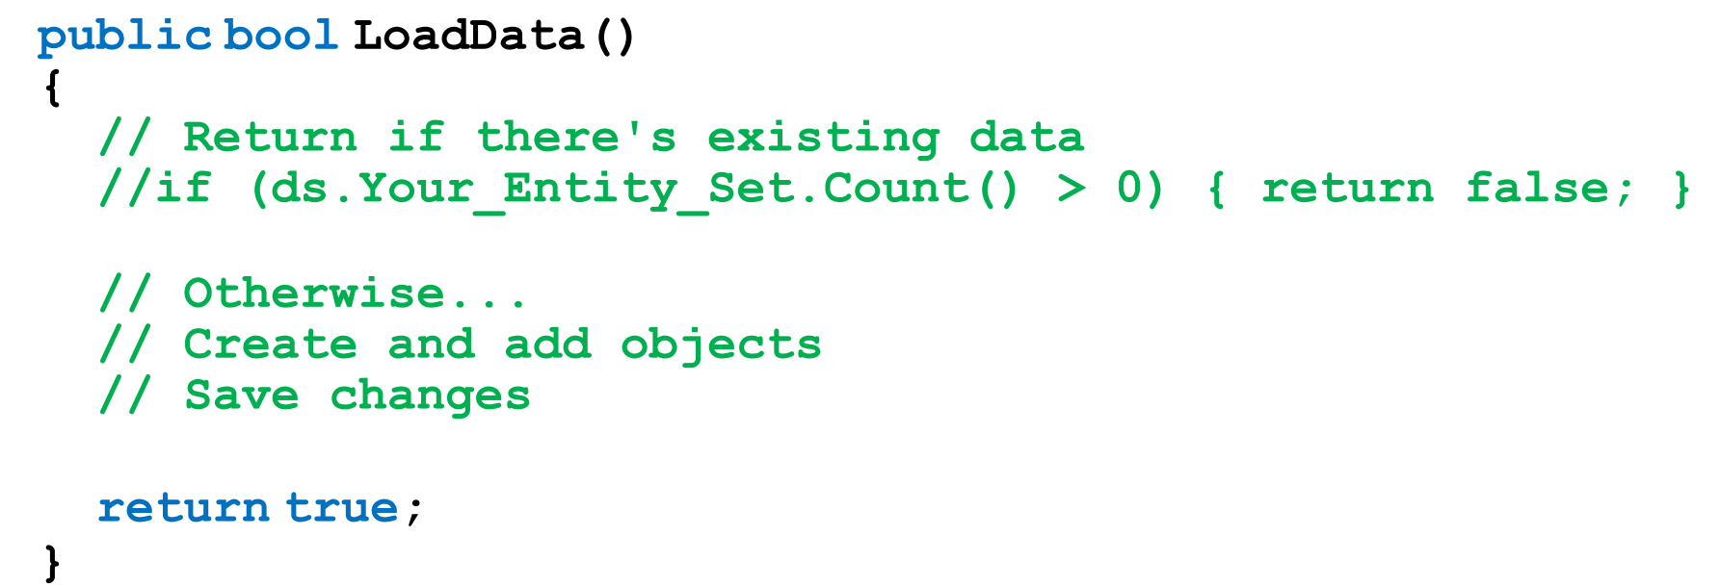
Using Manager to Programmatically Add New Objects
In this strategy, we can code one or more Manager class methods that add programmatically-generated objects into the data store.
The “…V2” project template includes one method example, that you can edit and use:

Slide 18
Using Manager to Add New Objects
Next, we will create a special-purpose (or throw-away) “LoadData” controller that calls into the Manager methods.
As the programmer, you can choose whether to “protect” the controller (and its methods) with an Authorize attribute.
You can choose to keep or delete the “LoadData” controller after it has done its job.

Slide 19
Making Changes to the Design of the Persistent Store

Slide 20
Making Changes to the Design of the Persistent Store
After an app is up-and-running, how do you handle a situation where you need to add another entity class to a design model? Or, add a property to a design model class? Or change a property’s configuration?
This can be done if you activate a feature named (Code First) Migrations. Its biggest benefit is that it will attempt to keep your existing data after minor changes to the design model and database.
It also helps us to publish our web app to a public host.

Slide 21
Configuring Migrations
Using Migrations requires three simple tasks:
Enable migrations.
After a change (or set of changes), add a “migration” definition.
Update the data store.
How to Enable Migrations:
In Visual Studio, open the Package Manager Console.
Type the following command. After you do this, you will not have to do it again for the current project: enable-migrations
This command configures the base, or start state, of your design model classes and persistent store implementation. The following is a typical result from running the “enable-migrations” command:

Slide 22
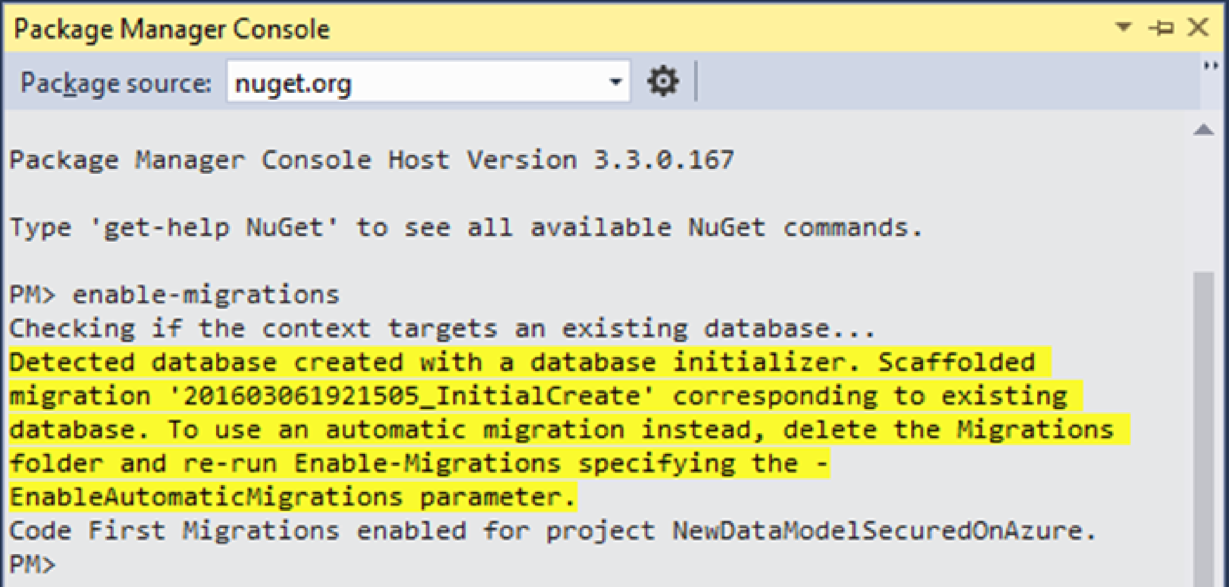

Slide 23
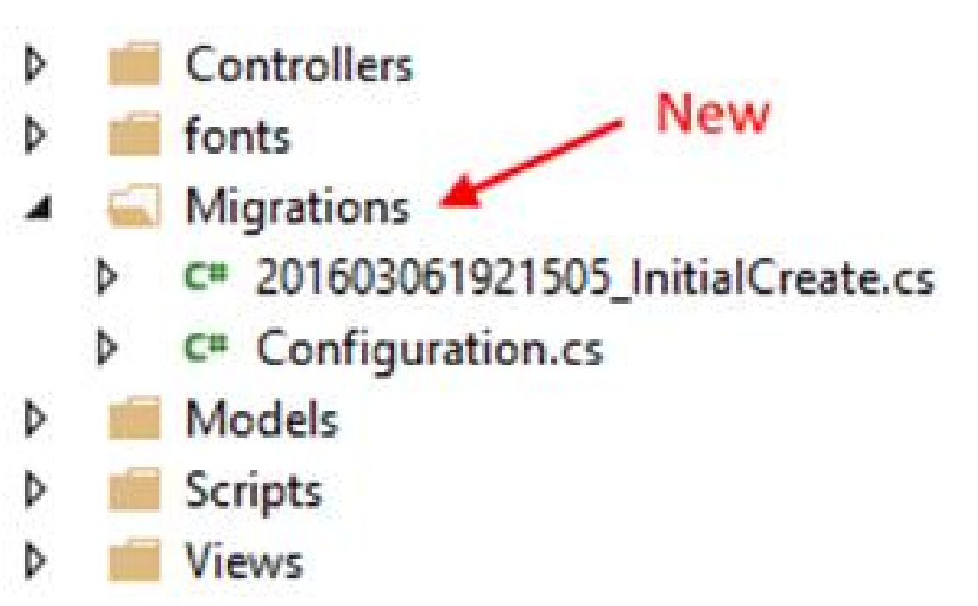
Enabling Migrations
After running the command, look in the Solution Explorer.
You will notice a new “Migrations” folder and two new code files.
The classes in these code files are used by the Entity Framework data migrator process and by the Microsoft Azure services publishing process.
Typically, we do not edit these classes.

Slide 24
Updating Migration Definitions
If you have existing data and have not made a change to your design model classes then you can skip the second task.
Read the package manager console messages carefully – it will tell you the status.
Later, whenever you have made a change to your design model classes, do the second task by executing the following two commands in the Package Manager Console: PM> add-migration descriptive_name_for_the_change PM> update-database
If you anticipate performing many changes then you can do the add-migration and update-database several times, or you could just make all your changes and run these commands once.

Slide 25
Migration Notes
Working with migrations is simple but it is easy to make it more complicated than it is.
Follow the guidance in this slide.
There’s some reference information that you could read/skim, to learn more about the technology:
Introduction and overview – Code First Migrations
What can you do if you run into trouble while using/configuring migrations? Try this, before contacting your teacher:
In Visual Studio Solution Explorer, delete the Migrations folder.
Do the first task described above – enable-migrations – which will re-write/re-create the migration code.

Slide 26
Major Design Model Changes
Changes to an existing property’s configuration will work correctly for data transformations and conversions that are implicit.
These “widening” transformations will work without any additional code or data preparation.
For our changes, let’s attempt to ensure that our changes are implicit in nature.

Slide 27
Major Design Model Changes
If the data transformation/conversion is “narrowing” in nature, which could cause loss of data or precision, then you must inspect and/or prepare the data before and after the property configuration change.
For example, if you plan to add a [StringLength(200)] attribute to a string property that did not have such an attribute already, it is possible that some objects in the data store will have property values that exceed 200 characters in length.
Before editing the property configuration, you must locate, and potentially edit/truncate, the existing data, so that the property configuration change will succeed.
For example, if you plan to convert a double property into an integer property, it is possible that some existing objects will have real numbers (with a decimal portion) in the property value. Before editing the property configuration, you must locate and edit the existing data.

Slide 28
Alternative Strategy to Preserve Data
An alternative strategy, which works for existing in-production apps, would involve several tasks:
Add a new property, which will hold the destination value.
As a special task, go through all objects in the entity set, and use data from the existing property to populate the desired value in the new property.
If you want to start using the new property in your manager and controller code, go ahead.
Alternatively, you could delete the old property, add it back again with the desired data type, go through all the objects in the entity set to copy from the property added in step 1 above, to the just-added-again property, and then finally, delete the property added in step 1 above

Slide 29
Real-world in-production handling of database changes
Real-world in-production apps tend to separate the persistence layer from the application.
In this technique, we create a “class library” project that defines and hosts the design model classes and data context. This action creates a “persistence layer” (aka “data layer” in some documentation sets).
In a web app project, we “add a reference” to the persistence layer, so that our Manager class can work with the data.
When we need changes to the database, then we can use traditional database administration tools to perform the modifications or Migrations.
If not using Migrations, we modify the code in the persistence layer project to match the new reality in the persistence layer.

Slide 30
CustomStoreForCarBusiness Code Example
Open and study the CustomStoreForCarBusiness code example.
Our problem domain is the familiar car business. It has classes for Country, Manufacturer, and Vehicle.
A country has zero or more manufacturers.
A manufacturer has a collection of vehicles.
A vehicle is associated with one manufacturer.

